Slide 1
Risk Management
Module 02

Slide 2
LEARNING OBJECTIVES
Upon completion of this material, you should be able to:
  Define risk management, risk identification, and risk control
  Describe how risk is identified and assessed
  Assess risk based on probability of occurrence and likely impact
  Explain the fundamental aspects of documenting risk via the process of risk assessment
Notes:
Upon completion of this chapter you should be able to:
Define risk management, risk identification, and risk control
Describe how risk is identified and assessed
Assess risk based on probability of occurrence and likely impact
Explain the fundamental aspects of documenting risk via the process of risk assessment

Slide 3
LEARNING OBJECTIVES (CONT’D.)‏
  Describe the various risk mitigation strategy options
  Identify the categories that can be used to classify controls
  Recognize the conceptual frameworks for evaluating risk controls and formulate a cost benefit analysis
  Describe how to maintain and perpetuate risk controls
Notes:
Upon completion of this chapter you should be able to:
Describe the various risk mitigation strategy options
Identify the categories that can be used to classify controls
Recognize the conceptual frameworks for evaluating risk controls and formulate a cost benefit analysis
Describe how to maintain and perpetuate risk controls

Slide 4
INTRODUCTION
Objective: Organizations must design and create safe environments in which business processes and procedures can function
Risk management: process of identifying and controlling risks facing an organization
Risk identification: process of examining an organization’s current information technology security situation or security posture of an organization’s IT
Risk control: applying controls to reduce risks to an organization’s data and information systems
Notes:
Introduction
The Security Systems Development Life Cycle (or SecSDLC) is a process framework or methodology that can be used in a flexible fashion to assist organizations in deploying information security initiatives.
Risk identification is the formal process of examining and documenting the current information technology security situation.
Risk identification is conducted within the larger process of identifying and justifying risk controls, known as risk management.

Slide 5
AN OVERVIEW OF
RISK MANAGEMENT
Know yourself: identify, examine, and understand the information and systems currently in place
Know the enemy: identify, examine, and understand threats facing the organization
Responsibility: each community of interest within an organization to manage risks that are encountered
Notes:
Know Ourselves
First, we must identify, examine, and understand the information and systems currently in place.
In order to protect our assets, defined here as the information and the systems that use, store, and transmit it, we have to understand everything about the information.
Once we have examined these aspects, we can then look at what we are already doing to protect the information and systems from the threats.

Slide 6
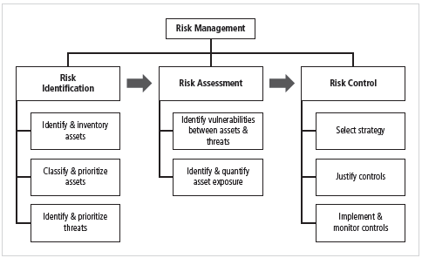
Figure: Components of Risk Management

Slide 7
THE ROLES OF THE COMMUNITIES OF INTEREST
Information security, management and users, and information technology all must work together
Communities of interest are responsible for:
  Evaluating the risk controls
  Determining which control options are cost effective for the organization
  Acquiring or installing the needed controls
  Ensuring that the controls remain effective
Notes:
Risk Management Process
Evaluating the risk controls
Determining which control options are cost effective for the organization
Acquiring or installing the needed controls
Ensuring that the controls remain effective

Slide 8
RISK IDENTIFICATION
Risk Identification refers examination and documentation of
  the security posture of an organization’s IT
  the risks organization’s IT faces
Risk management involves
  identifying, classifying, and prioritizing an organization’s assets
A threat assessment process identifies and quantifies the risks facing each asset
Components of risk identification
  People
  Procedures
  Data
  Software
  Hardware
Notes:
Risk Identification
A risk management strategy calls on us to “know ourselves” by identifying, classifying, and prioritizing the organization’s information assets.
These assets are the targets of various threats and threat agents, and our goal is to protect them from these threats.
Once we have gone through the process of self-examination, we then move into threat identification.
We must assess the circumstances and setting of each information asset.
To begin managing the risk from the vulnerabilities, we must identify those vulnerabilities and begin exploring the controls that might be used to manage the risks.
We begin the process by identifying and assessing the value of our information assets.

Slide 9
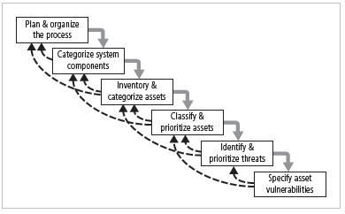
Figure: Components of Risk Identification

Slide 10
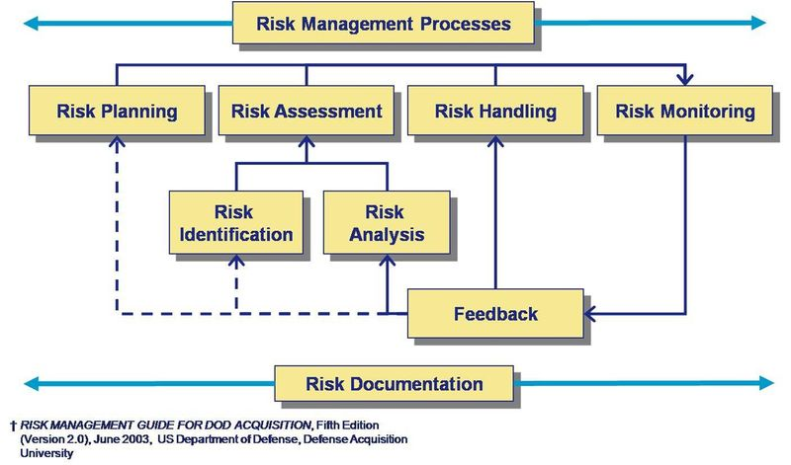
PLAN AND ORGANIZE THE PROCESS

Slide 11
PLAN AND ORGANIZE THE PROCESS
Risk Identification process is to
  Follow project management principles
  Organizing a team with representation across all affected groups (Users, Managers, IT, InfoSec groups)
The process must then be planned out with
  Periodic deliverables
  Reviews
  Presentations to management
Once project is approved and ready to begin, the following should be performed in kick off meeting
  Tasks laid out
  Assignments made
  Timetables discussed

Slide 12

ASSET IDENTIFICATION AND INVENTORY

Slide 13
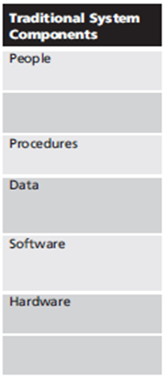
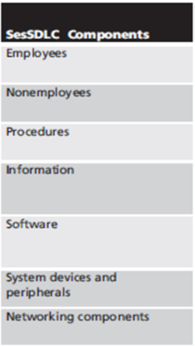
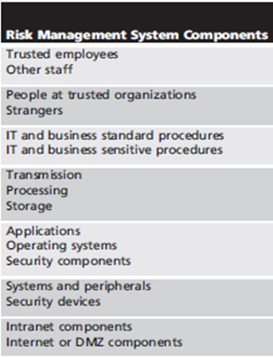
ASSET IDENTIFICATION AND INVENTORY
It’s a Iterative process;
Begins with identification of assets, including all elements of an organization’s system (people, procedures, data and information, software, hardware, networking)‏
Assets are then classified and categorized (objective to prioritize the asset)

Slide 14
PEOPLE, PROCEDURES, AND DATA ASSET IDENTIFICATION
Human resources, documentation, and data information assets are more difficult to identify
People with knowledge, experience, & judgement should be assigned the task.
As the people, procedures, & data are identified, they should be recorded using a reliable data-handling process.
Record keeping mechanism should ensure flexibility to allow specification of attributes particular to the type of asset.
Notes:
People, Procedures, and Data Asset Identification
Unlike the tangible hardware and software elements already described, the human resources, documentation, and data information assets are not as readily discovered and documented.
These assets should be identified, described, and evaluated by people using knowledge, experience, and judgment.
As these elements are identified, they should also be recorded into some reliable data-handling process.
For People:
Position name/number/ID – Try to stay away from names and stick to identifying positions, roles or functions
Supervisor
Security clearance level
Special skills

Slide 15
PEOPLE, PROCEDURES, AND DATA ASSET IDENTIFICATION (CONT.)
Important asset attributes:
  People: position name/number/ID; supervisor; security clearance level (level of authorization that the user can view); special skills
  Procedures: description; intended purpose; what elements it is tied to; storage location for reference; storage location for update
  Data: classification; owner/creator/ manager; data structure size; data structure used; online/offline; location; backup procedures employed
Notes:
People, Procedures, and Data Asset Identification
Unlike the tangible hardware and software elements already described, the human resources, documentation, and data information assets are not as readily discovered and documented.
These assets should be identified, described, and evaluated by people using knowledge, experience, and judgment.
As these elements are identified, they should also be recorded into some reliable data-handling process.
For People:
Position name/number/ID – Try to stay away from names and stick to identifying positions, roles or functions
Supervisor
Security clearance level
Special skills

Slide 16
HARDWARE, SOFTWARE, AND NETWORK ASSET IDENTIFICATION
What information attributes need to track?
Depends on:
  Needs of organization / Risk management efforts
  Preferences/needs of the security and IT communities
Asset attributes to be considered are: Name; IP address; MAC address; element type (e.g. server, desktop, network device, test equipment, etc.); Serial number; Manufacturer name; Model/Part number; Software version; Physical or logical location; Controlling entity (which organizational unit controls the element)
Automated tools can identify system elements for hardware, software, and network components
Notes:
Hardware, Software, and Network Asset Identification
Automated tools can sometimes uncover the system elements that make up the hardware, software, and network components.
Once created and stored, the inventory listing must be kept current, often through a tool that periodically refreshes the data.

Slide 17
DATA CLASSIFICATION AND MANAGEMENT

Slide 18
DATA CLASSIFICATION & MANAGEMENT
Variety of classification schemes used by corporate and military organizations
Information owners responsible for classifying their information assets
Information classifications must be reviewed periodically
Most organizations do not need detailed level of classification used by military or federal agencies; however, organizations may need to classify data to provide protection
Notes:
Data Classification and Management
A variety of classification schemes are used by corporate and military organizations.
Information owners are responsible for classifying the information assets for which they are responsible.
At least once a year, information owners must review information classifications to ensure the information is still classified correctly and the appropriate access controls are in place.
The U.S. Military Classification Scheme has a more complex categorization system than required by most corporations. For most information, the military uses a five-level classification scheme: Unclassified, Sensitive But Unclassified (i.e., For Official Use Only), Confidential, Secret, and Top Secret.
Most organizations do not need the detailed level of classification used by the military or federal agencies. A simple scheme will allow the organization to protect its sensitive information, such as: Public, For official use only, Sensitive, Classified.

Slide 19
DATA CLASSIFICATION & MANAGEMENT
Security clearance structure
  Each data user assigned a single level of authorization indicating classification level
  Before accessing specific set of data, employee must meet need-to-know requirement
Management of Classified Data
Storage (only available to the authorized individual), distribution (should be in secured channel), portability, and destruction of classified data
Clean desk policy
Dumpster diving
Notes:
Security Clearances
The other side of the data classification scheme is the personnel security clearance structure. For each user of data in the organization, a single level of authorization must be assigned, indicating the level of classification he or she is authorized to view.
Before individuals are allowed access to a specific set of data, they must meet the need-to-know requirement.
This extra level of protection ensures that the confidentiality of information is properly maintained.
Management of Classified Data
Requirements for the management of information include the storage, distribution, portability, and destruction of classified information.
Information that has a classification designation other than unclassified or public must be clearly marked as such.
When classified data is stored, it must be unavailable to unauthorized individuals.
When an individual carries classified information, it should be inconspicuous, as in a locked briefcase or portfolio.
The clean desk policy requires each employee to secure any and all information in its appropriate storage container at the end of each day.
When classified information is no longer valuable or excessive copies exist, proper care should be taken to destroy any unneeded copies through shredding, burning, or transfer to an authorized document destruction service.
There are those individuals who would not hesitate to engage in dumpster diving to retrieve information that could prove embarrassing or compromise the security of information in the organization.

Slide 20
CLASSIFYING AND PRIORITIZING INFORMATION ASSETS
Many organizations have data classification schemes (e.g., confidential, internal/private, public data)‏
Classification of components must be specific to allow determination of priority levels (e.g., critical, high, medium, low)
Notes:
Information Asset Classification
Many organizations already have a classification scheme.
Examples of these kinds of classifications are confidential data, internal data, and public data. Informal organizations may have to organize themselves to create a usable data classification model.
The other side of the data classification scheme is the personnel security clearance structure, identifying the level of information each individual is authorized to view, based on his or her need-to-know.

Slide 21
INFORMATION ASSET VALUATION
Questions help develop criteria for asset valuation
Which information asset:
  Is most critical to organization’s success?
  Generates the most revenue/profitability?
  Would be most expensive to replace or protect?
  Would be the most embarrassing or cause greatest liability if revealed?
Notes:
Information Asset Valuation
As each asset of the organization is assigned to its category, these questions will assist in developing the criteria to be used for asset valuation:
Which information asset is the most critical to the success of the organization?
Which information asset generates the most revenue?
Which information asset generates the most profitability?
Which information asset would be the most expensive to replace?
Which information asset would be the most expensive to protect?
Which information asset would be the most embarrassing or cause the greatest liability if revealed?

Slide 22
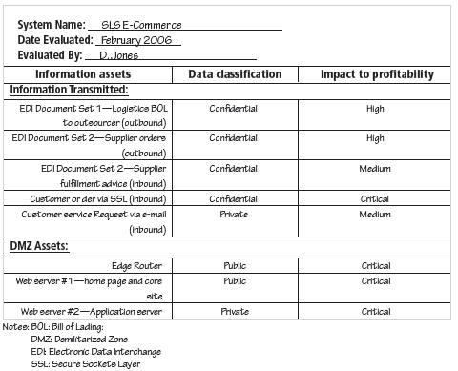
Figure: Sample Inventory Worksheet (Asset Valuation)

Slide 23
INFORMATION ASSET VALUATION (CONT’D.)
Information asset prioritization
  Create weighting for each category based on the answers to questions
  Calculate relative importance of each asset using weighted factor analysis
  List the assets in order of importance using a weighted factor analysis worksheet
Notes:
Information Asset Valuation (cont’d.)
In order to finalize this step of the information asset identification process, each organization should create a weighting for each category based on the answers to the previous questions.
Which factor is the most important to the organization?
Once each question has been weighted, calculating the importance of each asset is straightforward. The final step is to list the assets in order of importance. This can be achieved by using a weighted factor analysis worksheet.

Slide 24
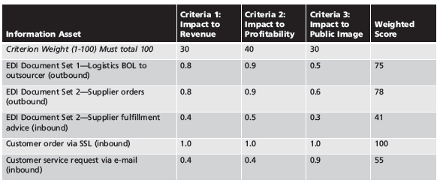
Table: Example of a Weighted Factor Analysis Worksheet
Notes: EDI: Electronic Data Interchange
SSL: Secure Sockets Layer

Slide 25
IDENTIFYING AND PRIORITIZING THREATS

Slide 26
IDENTIFYING AND PRIORITIZING THREATS
Realistic threats need investigation;
Unimportant threats are set aside
Threat assessment:
  Which threats present danger to assets?
  Which threats represent the most danger to information?
  How much would it cost to recover from attack?
  Which threat requires greatest expenditure to prevent?
Notes:
Threat Identification
Each of these threats identified has the potential to attack any of the assets protected.
If we assume every threat can and will attack every information asset, this will quickly become more complex and overwhelm the ability to plan.
To make this part of the process manageable, each step in the threat identification and vulnerability identification process is managed separately and then coordinated at the end of the process.

Slide 27
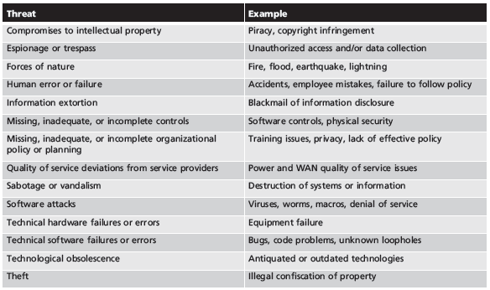
Table: Threats to Information Security

Slide 28
VULNERABILITY IDENTIFICATION
Specific reasons where threat agents can exploit to attack an information asset are called vulnerabilities.
Examine how each threat could be executed and list organization’s assets and vulnerabilities
Process works best when people with diverse backgrounds within organization work iteratively in a series of brainstorming sessions
At end of risk identification process, list of assets and their vulnerabilities is achieved
Notes:
Vulnerability Identification
We now face the challenge of reviewing each information asset for each threat it faces and creating a list of the vulnerabilities that remain viable risks to the organizations.
Vulnerabilities are specific avenues that threat agents can exploit to attack an information asset.

Slide 29
Risk Assessment

Slide 30
RISK ASSESSMENT
Risk assessment evaluates the relative risk for each vulnerability
Assigns a risk rating or score to each information asset
The goal at this point:
  create a method for evaluating the relative risk of each listed vulnerability
Principles of Information Security, Fourth Edition
Notes:
Risk Assessment
We can determine the relative risk for each of the vulnerabilities through a process called risk assessment.
Risk assessment assigns a risk rating or score to each specific information asset, which is useful in gauging the relative risk introduced by each vulnerable information asset and making comparative ratings later in the risk control process.

Slide 31
LIKELIHOOD
The probability that a specific vulnerability will be
  the object of a successful attack
Assign numeric value:
  number between 0.1 (low) and 1.0 (high), or
  a number between 1 and 100
Zero not used since vulnerabilities with zero likelihood are removed from asset/vulnerability list
Use selected rating model consistently
Use external references for values that have been reviewed/adjusted for your circumstances

Slide 32
RISK DETERMINATION
For the purpose of relative risk assessment:
Risk = {(Likelihood vulnerability occurrence) x (value/impact)}
– (% risk already controlled) + (an element of
Uncertainty)
  Risk EQUALS
  Likelihood of vulnerability occurrence
  TIMES value (or impact)‏
  MINUS percentage risk already controlled
  PLUS an element of uncertainty
Notes:
Risk Determination
For the purpose of relative risk assessment:
risk =
likelihood of vulnerability occurrence
times
value (or impact)
minus
percentage risk already controlled
plus
an element of uncertainty

Slide 33
Exercise
Information asset A has a value score of 50 and has one vulnerability. Vulnerability 1 has a likelihood of 1.0 with no current controls. You estimate that assumptions and data are 90 percent accurate.
Information asset B has a value score of 100 and has two vulnerabilities:
  Vulnerability 2 has a likelihood of 0.5 with a current control that addresses 50 percent of its risk;
  vulnerability 3 has a likelihood of 0.1 with no current controls.
  You estimate that assumptions and data are 80 percent accurate.

Slide 34
Exercise
Switch L47 connects a network to the Internet. It has two vulnerabilities: it is susceptible to hardware failure at a likelihood of 0.2, and it is subject to an SNMP buffer overflow attack at a likelihood of 0.1. This switch has an impact rating of 90 and has no current controls in place. You are 75 percent certain of the assumptions and data.
Server WebSrv6 hosts a company Web site and performs e-commerce transactions. It has a Web server version that can be attacked by sending it invalid Unicode values. The likelihood of that attack is estimated at 0.1. The server has been assigned an impact value of 100, and a control has been implanted that reduces the impact of the vulnerability by 75 percent. You are 80 percent certain of the assumptions and data.

Slide 35
Exercise
Operators use an MGMT45 control console to monitor operations in the server room. It has no passwords and is susceptible to unlogged misuse by the operators. Estimates show the likelihood of misuse is 0.1. There are no controls in place on this asset; it has an impact rating of 5. You are 90 percent certain of the assumptions and data.

Slide 36
IDENTIFY POSSIBLE CONTROLS

Slide 37
IDENTIFY POSSIBLE CONTROLS
For each threat and associated vulnerabilities that have residual risk, create preliminary list of control ideas
Residual risk is risk that remains to information asset even after existing control has been applied
There are three general categories of controls:
  Policies
  Programs
  Technologies
Notes:
Identify Possible Controls
For each threat and its associated vulnerabilities that have any residual risk, create a preliminary list of control ideas.
Residual risk is the risk that remains to the information asset even after the existing control has been applied.

Slide 38
Documenting the Results of Risk Assessment
Final summary comprised in ranked vulnerability risk worksheet
Worksheet details asset, asset impact, vulnerability, vulnerability likelihood, and risk-rating factor
Ranked vulnerability risk worksheet is initial working document for next step in risk management process: assessing and controlling risk
Notes:
Documenting Results of Risk Assessment
The goal of this process has been to identify the information assets of the organization that have specific vulnerabilities and create a list of them, ranked for focus on those most needing protection first.
In preparing this list, we have collected and preserved a wealth of factual information about the assets, the threats they face, and the vulnerabilities they experience.
We should also have collected some information about the controls that are already in place.

Slide 39
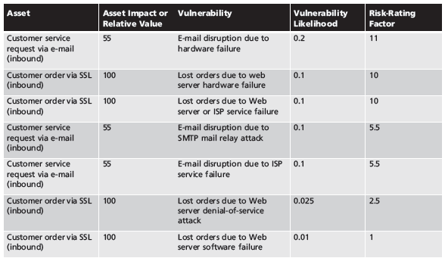
Table 4-9 Ranked Vulnerability Risk Worksheet
Principals of Information Security, Fourth Edition

Slide 40
Deliverable | Purpose
Information asset classification worksheet | Assembles information about information assets and their impact
Weighted criteria analysis worksheet | Assigns ranked value or impact weight to each information asset
Ranked vulnerability risk worksheet | Assigns ranked value of risk rating for each uncontrolled asset-vulnerability pair
Table: Risk Identification and Assessment Deliverables

Slide 41
Risk Control Strategies
Once ranked vulnerability risk worksheet complete, must choose one of five strategies to control each risk:
  Defend
  Transfer
  Mitigate
  Accept
  Terminate
Notes:
Risk Control Strategies
When organizational management has determined that risks from information security threats are creating a competitive disadvantage, they empower the information technology and information security communities of interest to control the risks.
Once the project team for information security development has created the Ranked Vulnerability Worksheet, the team must choose one of four basic strategies to control the risks that result from these vulnerabilities.
The four risk strategies guide an organization to:
1. Apply safeguards that eliminate or reduce the remaining uncontrolled risks for the vulnerability (avoidance)
2. Transfer the risk to other areas or to outside entities (transference)‏
3. Reduce the impact should the vulnerability be exploited (mitigation)‏
4. Inform themselves of all of the consequences and accept the risk without control or mitigation (acceptance)‏

Slide 42
Defend
Attempts to prevent exploitation of the vulnerability
Preferred approach
Accomplished through countering threats, removing asset vulnerabilities, limiting asset access, and adding protective safeguards
Three common methods of risk avoidance:
  Application of policy
  Training and education
  Applying technology
Notes:
Defend
Defend is the risk control strategy that attempts to prevent the realization or exploitation of the vulnerability. This is the preferred approach, as it seeks to avoid risk in its entirety rather than deal with it after it has been realized.
Avoidance is accomplished through countering threats, removing vulnerabilities in assets, limiting access to assets, and/or adding protective safeguards.
The most common methods of avoidance involve three areas of controls, avoidance through application of policy, training and education, and technology.

Slide 43
Transfer
Control approach that attempts to shift risk to other assets, processes, or organizations
If lacking, organization should hire individuals/firms that provide security management and administration expertise
Organization may then transfer risk associated with management of complex systems to another organization experienced in dealing with those risks
Notes:
Transfer
Transfer is the control approach that attempts to shift the risk to other assets, other processes, or other organizations.
If an organization does not already have quality security management and administration experience, it should hire individuals or firms that provide such expertise.
This allows the organization to transfer the risk associated with the management of these complex systems to another organization with established experience in dealing with those risks.

Slide 44
Mitigate
Attempts to reduce impact of vulnerability exploitation through planning and preparation
Approach includes three types of plans
  Incident response plan (IRP): define the actions to take while incident is in progress
  Disaster recovery plan (DRP): most common mitigation procedure
  Business continuity plan (BCP): encompasses continuation of business activities if catastrophic event occurs
Notes:
Mitigation
Mitigation is the control approach that attempts to reduce the impact caused by the exploitation of vulnerability through planning and preparation.
This approach includes three types of plans: disaster recovery planning (DRP), business continuity planning (BCP), and incident response planning (IRP).
Mitigation begins with the early detection that an attack is in progress.
The most common of the mitigation procedures is the disaster recovery plan.
The DRP includes the entire spectrum of activities to recover from an incident. The DRP can include strategies to limit losses before and during the disaster.
DRPs usually include all preparations for the recovery process, strategies to limit losses during the disaster, and detailed steps to follow when the disaster has ended.
The actions an organization can and perhaps should take while the incident is in progress should be defined in a document referred to as the incident response plan or IRP.
The IRP provides answers to questions victims might pose in the midst of a disaster.
It answers the questions:
What do I do NOW?!
What should the administrators do first?
Who should they contact?
What should they document?
DRP and IRP planning overlap to a degree. In many regards, the DRP is the subsection of the IRP that covers disastrous events.
While some DRP and IRP decisions and actions are the same, their urgency and results can differ dramatically.
The DRP focuses more on preparations completed before and actions taken after the incident, while the IRP focuses on intelligence gathering, information analysis, coordinated decision making, and urgent, concrete actions.
The third type of planning document under mitigation is the business continuity plan or BCP.
The BCP is the most strategic and long-term plan of the three plans. It encompasses the continuation of business activities if a catastrophic event occurs, such as the loss of an entire database, building, or operations center.
The BCP includes planning for the steps to insure the continuation of the organization when the scope or scale of a disaster exceeds the DRP’s ability to restore operations.

Slide 45
Accept
Doing nothing to protect a vulnerability and accepting the outcome of its exploitation
Valid only when the particular function, service, information, or asset does not justify cost of protection
Notes:
Accept
With the acceptance control approach, an organization evaluates the risk of a vulnerability and allows the risky state to continue as is.
The only acceptance strategy that is recognized as valid occurs when the organization has:
Determined the level of risk
Assessed the probability of attack
Estimated the potential damage that could occur from these attacks
Performed a thorough cost benefit analysis
Evaluated controls using each appropriate type of feasibility
Decided that the particular function, service, information, or asset did not justify the cost of protection
Acceptance of risk is the choice to do nothing to protect a vulnerability and to accept the outcome of its exploitation.
This control, or rather lack of control, is based on the assumption that it may be a prudent business decision to examine the alternatives and determine that the cost of protecting an asset does not justify the security expenditure.
The term risk appetite is used to describe the degree to which an organization is willing to accept risk as a trade-off to the expense of applying controls.

Slide 46
Terminate
Directs the organization to avoid those business activities that introduce uncontrollable risks
May seek an alternate mechanism to meet customer needs
Principals of Information Security, Fourth Edition
Notes:
Terminate
The terminate control strategy directs the organization to avoid those business activities that introduce uncontrollable risks.

Slide 47
Selecting a Risk Control Strategy
Level of threat and value of asset play major role in selection of strategy
Rules of thumb on
Strategy selection can be applied:
  When a vulnerability exists
  When a vulnerability can be exploited
  When attacker’s cost is less than potential gain
  When potential loss is substantial (i.e. Large)
Notes:
Mitigation Strategy Selection
The level of threat and value of the asset should play a major role in the selection of strategy.
The following rules of thumb can be applied in selecting the preferred strategy:
When a vulnerability exists, implement assurance techniques to reduce the likelihood of a vulnerability being exercised.
When a vulnerability can be exploited, apply layered protections, architectural designs, and administrative controls to minimize the risk or prevent this occurrence.
When the attacker’s cost is less than his or her potential gain, apply protections to increase the attacker’s cost (e.g., use system controls to limit what a system user can access and do, thereby significantly reducing an attacker’s gain).
When potential loss is substantial, apply design principles, architectural designs, and technical and nontechnical protections to limit the extent of the attack, thereby reducing the potential for loss.

Slide 48
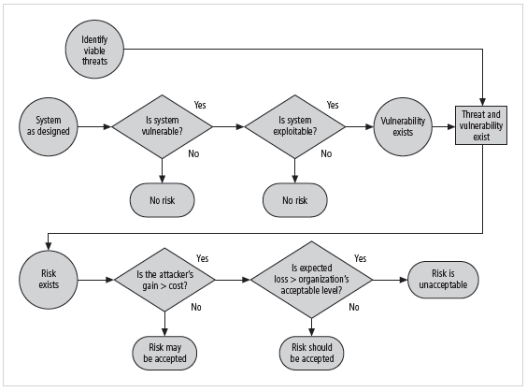
Figure 4-8 Risk Handling Decision Points

Slide 49
Feasibility Studies
Before deciding on strategy, all information about
  economic/noneconomic consequences of vulnerability on information asset must be explored
A number of ways exist to determine advantage of a specific control
Notes:
Feasibility Studies and the Cost Benefit Analysis
Before deciding on the strategy for a specific vulnerability, all information about the economic and noneconomic consequences of the vulnerability facing the information asset must be explored.
Fundamentally we are asking, “What are the actual and perceived advantages of implementing a control contrasted with the actual and perceived disadvantages of implementing the control?”

Slide 50
Cost Benefit Analysis (CBA)‏
Begun by evaluating
  worth of assets to be protected and
  loss in value (if they are compromised)
The formal process to document the above is called cost benefit analysis or economic feasibility study
Items that affect cost of a control or safeguard include:
  cost of development or acquisition;
  training fees;
  implementation cost;
  service costs;
  cost of maintenance
Benefit: value an organization realizes using controls to prevent losses from a vulnerability
Notes:
Cost Benefit Analysis (CBA)‏
The approach most commonly considered for a project of information security controls and safeguards is the economic feasibility of implementation.
An organization begins by evaluating the worth of the information assets to be protected and the loss in value if those information assets are compromised by the specific vulnerability.
It is only common sense that an organization should not spend more to protect an asset than it is worth.
The formal process to document this is called a cost benefit analysis or an economic feasibility study.
CBA: Factors
Some of the items that impact the cost of a control or safeguard include:
Cost of development or acquisition
Training fees
Cost of implementation
Service costs
Cost of maintenance

Slide 51
Cost Benefit Analysis (CBA) (cont’d.)‏
Asset valuation: process of assigning financial value or worth to each information asset
Process result is estimate of potential loss per risk
Expected loss per risk stated in the following equation:
  ALE = SLE x ARO
  Where,
  ALE = Annualized loss expectancy
  SLE = Single loss expectancy
  ARO = Annualized rate of occurrence‏ (how often you expect a
  specific type of attack to occur)
  SLE = Asset Value × Exposure Factor (EF)‏
Where,
EF = Percentage loss that would occur from a given vulnerability
being exploited
Notes:
CBA: Loss Estimates
Once an organization has estimated the worth of various assets, it can begin to examine the potential loss that could occur from the exploitation of vulnerability or a threat occurrence. This process results in the estimate of potential loss per risk.
The questions that must be asked here include:
What damage could occur, and what financial impact would it have?
What would it cost to recover from the attack, in addition to the costs from the previous question?
What is the single loss expectancy for each risk?

Slide 52
The Cost Benefit Analysis (CBA) Formula
CBA determines if alternative being evaluated is worth cost incurred to control vulnerability
  CBA most easily calculated using ALE from earlier assessments, before implementation of proposed control:
    CBA = ALE(prior) – ALE(post) – ACS
    Where,
    ALE(prior) = Annualized loss expectancy of risk before implementation of control
    ALE(post) = Estimated ALE based on control being in place for a period of time
    ACS = Annualized cost of the safeguard
Notes:
CBA: Formula
In its simplest definition, CBA is whether or not the control alternative being evaluated is worth the associated cost incurred to control the specific vulnerability.
While many CBA techniques exist, for our purposes, the CBA is most easily calculated using the ALE from earlier assessments.
CBA = ALE(prior) – ALE(post) – ACS
ALE prior is the Annualized Loss Expectancy of the risk before the implementation of the control.
ALE post is the ALE examined after the control has been in place for a period of time.
ACS is the Annual Cost of the Safeguard.

Slide 53
Evaluation, Assessment, and Maintenance of Risk Controls
Selection and implementation of control strategy is not end of process
Strategy and accompanying controls must be monitored/reevaluated on ongoing basis to determine effectiveness and to calculate more accurately the estimated residual risk
Process continues as long as organization continues to function

Slide 54
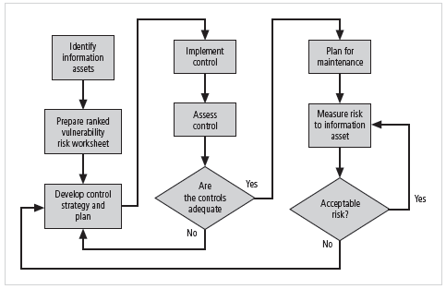
Figure 4-9 Risk Control Cycle

Slide 55
Quantitative versus Qualitative Risk Control Practices
Performing the previous steps using actual values or estimates is known as quantitative assessment
Possible to complete steps using evaluation process based on characteristics using nonnumerical measures; called qualitative assessment
Utilizing scales rather than specific estimates relieves organization from difficulty of determining exact values

Slide 56
Benchmarking and Best Practices
An alternative approach to risk management
Benchmarking: process of seeking out and studying practices in other organizations that one’s own organization desires to duplicate
One of two measures typically used to compare practices:
  Metrics-based measures
  Process-based measures
Notes:
Benchmarking
An alternative strategy to the cost benefit analysis and its attempt to place a hard dollar figure on each information asset is to approach risk management from a different angle.
Instead of determining the financial value of information and then implementing security as an acceptable percentage of that value, an organization could look at peer institutions to determine what others are doing to protect their information (benchmarking).
Benchmarking is the process of seeking out and studying the practices used in other organizations that produce the results you desire in your organization.
When benchmarking, an organization typically uses one of two measures to compare practices, to determine which practices it would prefer to implement.
These are metrics-based measures and process-based measures.
Metrics-based measures are comparisons based on numerical standards, such as:
Numbers of successful attacks
Staff-hours spent on systems protection
Dollars spent on protection
Numbers of security personnel
Estimated losses in dollars of information due to successful attacks
Loss in productivity hours associated with successful attacks
An organization uses this information by ranking competitive businesses within a similar size or market and determining how their measures compare to others.
Process-based measures are generally less number-focused and more strategic than metrics-based measures.
For each of the areas the organization is interested in benchmarking, process-based measures enable the companies to examine the activities an individual company performs in pursuit of its goal, rather than the specifics of how goals were attained.
The primary focus is the method the organization uses to accomplish a particular process, rather than the outcome.
In information security, two categories of benchmarks are used: standards of due care/due diligence and best practices.
Within best practices is a subcategory of practices referred to as the gold standard, those practices typically viewed as “the best of the best.”

Slide 57
Metrics-based Measures
Metrics-based measures are comparisons based on numerical standards, such as:
  Numbers of successful attacks
  Staff-hours spent on systems protection
  Dollars spent on protection
  Numbers of security personnel
  Estimated value in dollars of the information lost in successful attacks
  Loss in productivity hours associated with successful attacks

Slide 58
Process-based Measures
Process-based measures are generally
  More focused on strategic factor than numbers;
  The primary focus is the method the organization uses to accomplish a particular process, rather than the outcome.
Two categories of benchmarks are used in information security:
  Standards of due care and due diligence, and
  Best practices.

Slide 59
Benchmarking and Best Practices (cont’d.)‏
Standard of due care: when adopting levels of security for a legal defense, organization shows it has done what any prudent organization would do in similar circumstances
Due diligence: demonstration that organization is diligent in ensuring that implemented standards continue to provide required level of protection
Notes:
Due Care/Due Diligence
When organizations adopt levels of security for a legal defense, they may need to show that they have done what any prudent organization would do in similar circumstances. This is referred to as a standard of due care.
It is insufficient to just implement these standards and then ignore them. The application of controls at or above the prescribed levels and the maintenance of those standards of due care show that the organization has performed due diligence.
Due diligence is the demonstration that the organization is diligent in ensuring that the implemented standards continue to provide the required level of protection.
Failure to support a standard of due care or due diligence can open an organization to legal liability, provided it can be shown that the organization was negligent in its application or lack of application of information protection.

Slide 60
Benchmarking and Best Practices (cont’d.)‏
Best business practices: security efforts that provide a superior level of information protection
When considering best practices for adoption in an organization, consider:
  Does organization resemble (similar) identified target with best practice?
  Are resources at hand similar?
  Is organization in a similar threat environment?
Notes:
Best Business Practices
Security efforts that seek to provide a superior level of performance in the protection of information are referred to as best business practices or simply best practices or recommended practices.
Best security practices (BSPs) are those security efforts that are among the best in the industry, balancing the need to access with the need to provide adequate protection.
Best practices seek to provide as much security as possible for information and systems while maintaining a solid degree of fiscal responsibility.
When considering best practices for adoption in your organization, consider the following:
Does your organization resemble the identified target organization of the best practice?
Are the resources you can expend similar to those identified in the best practice? A best practice proposal that assumes unlimited funding and does not identify needed trade-offs will be of limited value if your approach has strict resource limits.
Are you in a similar threat environment as that proposed in the best practice? A proposal of best practice from months and even weeks ago may not be appropriate for the current threat environment.

Slide 61
Benchmarking and Best Practices (cont’d.)‏
Problems with the application of benchmarking and best practices
  Organizations don’t talk to each other (biggest problem)‏
  No two organizations are identical
  Best practices are a moving target
  Knowing what was going on in information security industry in recent years through benchmarking doesn’t necessarily prepare for what’s next
Notes:
Problems with Benchmarking and Best Practices
The biggest problem with benchmarking in information security is that organizations don’t talk to each other.
Another problem with benchmarking is that no two organizations are identical.
A third problem is that best practices are a moving target. What worked well two years ago may be completely worthless against today’s threats.
One last issue to consider is that simply knowing what was going on a few years ago, as in benchmarking, doesn’t necessarily tell us what to do next.

Slide 62
Benchmarking and Best Practices (cont’d.)‏
Baselining
  Analysis of measures against established standards
  In information security, baselining is comparison of security activities and events against an organization’s future performance
  Useful during baselining to have a guide to the overall process
Notes:
Baselining
Baselining is the analysis of measures against established standards.
In information security, baselining is the comparison of security activities and events against the organization’s future performance.
When baselining, it is useful to have a guide to the overall process.

Slide 63
Other Feasibility Studies
Organizational: examines how well proposed IS alternatives will contribute to organization’s efficiency, effectiveness, and overall operation
Operational: examines user and management acceptance and support, and the overall requirements of the organization’s stakeholders
Technical: examines if organization has or can acquire the technology necessary to implement and support the control alternatives
Political: defines what can/cannot occur based on consensus and relationships
Notes:
Organizational Feasibility
Organizational feasibility examines how well the proposed information security alternatives will contribute to the efficiency, effectiveness, and overall operation of an organization.
Above and beyond the impact on the bottom line, the organization must determine how the proposed alternatives contribute to the business objectives of the organization.

Slide 64
Risk Management Discussion Points
Organization must define level of risk it can live with
Risk appetite: defines quantity and nature of risk that organizations are willing to accept as trade-offs between perfect security and unlimited accessibility
Residual risk: risk that has not been completely removed, shifted, or planned for
Notes:
Risk Management Discussion Points
Not every organization has the collective will to manage each vulnerability through the application of controls.
Depending on the willingness to assume risk, each organization must define its risk appetite.
Risk appetite defines the quantity and nature of risk that organizations are willing to accept as they evaluate the trade-offs between perfect security and unlimited accessibility.

Slide 65
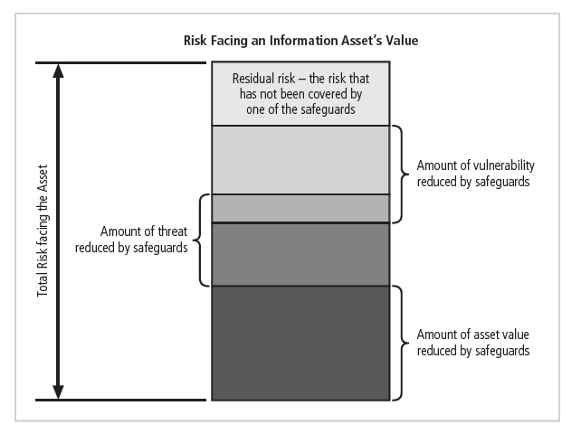
Figure 4-10 Residual risk

Slide 66
Documenting Results
At minimum, each information asset-threat pair should have documented control strategy clearly identifying any remaining residual risk
Another option: document outcome of control strategy for each information asset-vulnerability pair as an action plan
Risk assessment may be documented in a topic-specific report
Notes:
Documenting Results
At minimum, each information asset-vulnerability pair should have a documented control strategy that clearly identifies any residual risk remaining after the proposed strategy has been executed.
Some organizations document the outcome of the control strategy for each information asset-vulnerability pair as an action plan.
This action plan includes concrete tasks, each with accountability assigned to an organizational unit or to an individual.

Slide 67
Recommended Risk Control Practices
Convince budget authorities to spend up to value of asset to protect from identified threat
Final control choice may be balance of controls providing greatest value to as many asset-threat pairs as possible
Organizations looking to implement controls that don’t involve such complex, inexact (incorrect), and dynamic calculations
Notes:
Recommended Practices in Controlling Risk
We must convince budget authorities to spend up to the value of the asset to protect a particular asset from an identified threat.
Each and every control or safeguard implemented will impact more than one threat-asset pair.
Between the impossible task associated with the valuation of information assets and the dynamic nature of the ALE calculations, it’s no wonder organizations are looking for a more straightforward method of implementing controls that doesn’t involve such imperfect calculations.

Slide 68
Summary
Risk identification: formal process of examining and documenting risk in information systems
Risk control: process of taking carefully reasoned steps to ensure the confidentiality, integrity, and availability of components of an information system
Risk identification
  A risk management strategy enables identification, classification, and prioritization of organization’s information assets
  Residual risk: risk remaining to the information asset even after the existing control is applied

Slide 69
Summary (continued)
Risk control: five strategies are used to control risks that result from vulnerabilities:
  Defend
  Transfer
  Mitigate
  Accept
  Terminate

Slide 70
Summary (continued)
Selecting a risk control strategy
  Cost Benefit Analysis
  Feasibility Study
Qualitative versus Quantitative Risk Control
  Best Practices and Benchmarks
  Organizational Feasibility, Operational Feasibility, Technical Feasibility, and Political Feasibility
Risk Appetite: organizational risk tolerance
Residual risk: risk remaining after application of risk controls

